Slide 1
1
Priyanka Goswami, H K College of Pharmacy
Drugs
Nutraceuticals
Alfalfa
Arnica
Apricot
Pits
Bran
Chamomile
Chicory
Cucumber
Fenugreek
Onion
Garlic
Gentian
Hydrocotyle
14. Hibiscus
15. Hops
16. Honey
17. Marigold
18. Amla
19. Ginseng
20. Ashwagandha
21. Ginkgo
22. Spirulina
23. Gymnema
24. Momordica
25. Tinospora

Slide 2
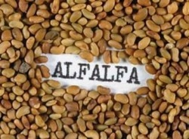
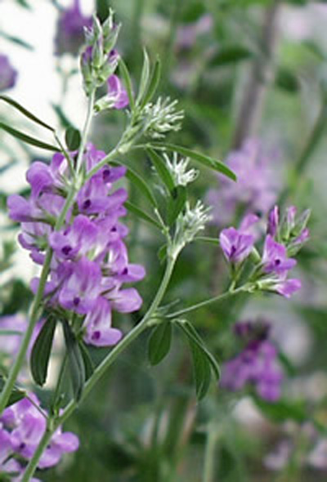
2
Priyanka Goswami, H K College of Pharmacy
1. Alfalfa
Syn: Wilayati gawuth, lusan
Source: dried seeds & whole flowering plant of Medicago sativa
Family: Leguminosae
GS: PB,GJ,MH,UP,TN
Constituents:
Leaves: Carotenoids, Triterpenoid saponin (medicagenic acid),isoflavonoids (genistein, daidzein)
Seeds: L-canavaine, betaine, trigonelline
Protein, amino acids, Vitamins, minerals , enzymes

Slide 3
3
Priyanka Goswami, H K College of Pharmacy
Indications:
Principle: Hypercholesterolemia; source of nutrients including vitamins
Major: Diabetes; malfunctioning of thyroid gland
Minor: Kidney, bladder & prostate disorders: asthma & arthritis
Dose: 5-10 g dried herb three times daily; 5-10 ml liquid extract 1:1 in 25% alcohol, three times daily
Classical Use:
Nutritive, digestive aid, ulcer, nervousness & insomnia

Slide 4
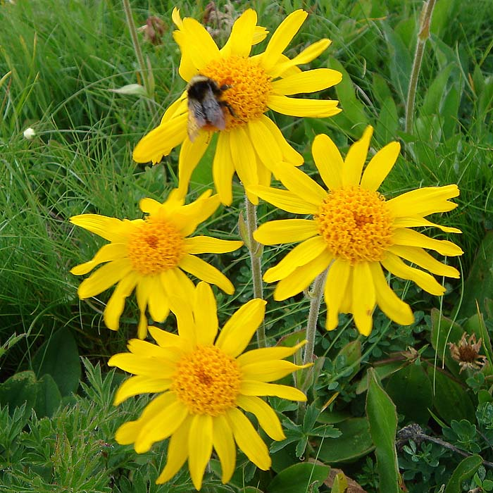
4
Priyanka Goswami, H K College of Pharmacy
2. Arnica
Syn: Leopard’s bane, Mountain tobacco
History: arnika=Ptarmikos=sternutatory or causing sneezing
Source: dried flower heads of Arnica montana
Family: Compositae
GS: Europe, US, Canda
Constituents: Flowers: Volatile oil, terpenoids, flavonoids, bitter principles:
Sesquiterpene lactone: helenanolides, arnifolin
Bitter principle: arnicin
Volatile oil: arnidiol, faradiol
Flavonoids: apigenin, quercetin, tricin

Slide 5
5
Priyanka Goswami, H K College of Pharmacy
Indications:
Major: dislocation, inflammation by insect bite, edema associated with fracture, rheumatic complains in muscles and joints
Minor: cardiac insufficiency, angina pectoris
ARNICA SHOULD NOT BE TAKEN INTERNALLY
Contraindications:
Hypersensitive to compositae family
Dose:
infusion: 2 g of arnica flower to 100 ml of water
Tincture: 1: 10 in 70% ethanol
Classical Use:
Nutritive, digestive aid, ulcer, nervousness & insomnia

Slide 6
6
Priyanka Goswami, H K College of Pharmacy
3. Apricot
Syn: Plume
Source: dried seed kernels of Prunus americana
Family: Rosaceae
GS: US-california
Constituents: Cyanogenetic glycoside: amygdaline, Vitamin A,C, Iron, beta carotene
Indication: Protect from Cancer, used in Heart problem, Anemia, Digestive aid, eye, skin Weight loss, Asthma, Bone, maintain Electrolyte balance

Slide 7
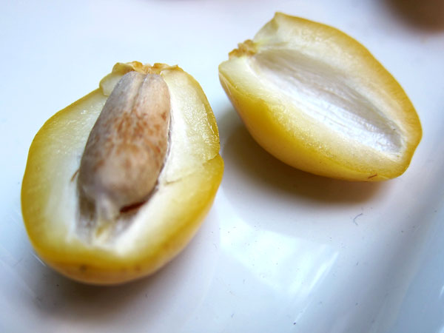
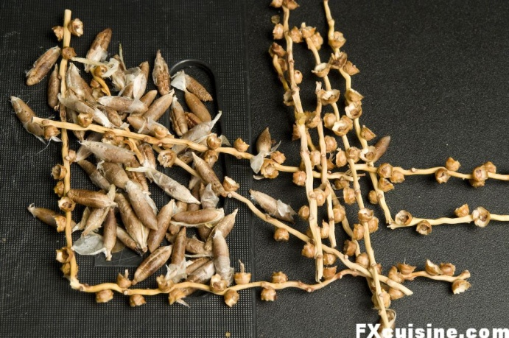
7
Priyanka Goswami, H K College of Pharmacy
4. Pits
Syn: Date pits, Khazoor
Source: dried fruits of Phoenix dactylifera
Family: Arecaceae
GS: India to Northen africa
Constituents:
Sugar: Saccharose, invert sugar
Leucoanthocyanidin, 10% fatty oil, iron
Piperidine derivative: pipecolic acid, baikiaine
Indication: bronchitis, clouding of cornea, headache, wound, kidney, gastric problems
Date honey: chest complaints

Slide 8
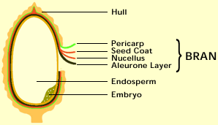
8
Priyanka Goswami, H K College of Pharmacy
5. Bran
Syn: miller's bran, is the hard outer layers of cereal grain.
Composition: It consists of the combined aleurone and pericarp, along with germ, it is an integral part of whole grains, and is often produced as a by-product of milling in the production of refined grains.
When bran is removed from grains, the grains lose a portion of their nutritional value.
Bran is present in and may be milled from any cereal grain, including rice, corn (maize), wheat, oats, barley and millet.
Bran should not be confused with chaff, which is coarser scaly material surrounding the grain, but not forming part of the grain itself.
Bran is particularly rich in dietary fiber and essential fatty acids and contains significant quantities of starch, protein, vitamins, dietary minerals and phytic acid, which is an antinutrient that prevents nutrient absorption.

Slide 9
9
Priyanka Goswami, H K College of Pharmacy
Rice bran is a byproduct of the rice milling process (the conversion of brown rice to white rice), and it contains various antioxidants that impart beneficial effects on human health. This fraction contains tocotrienols (a form of vitamin E), gamma-oryzanol and beta-sitosterol; all these constituents may contribute to the lowering of the plasma levels of the various parameters of the lipid profile.
Rice bran also contains a high level of dietary fibres (beta-glucan, pectin and gum). In addition, it also contains ferulic acid, which is also a component of the structure of nonlignified cell walls.
The high oil content of bran makes it subject to rancidification, one of the reasons that it is often separated from the grain before storage or further processing. The bran itself can be heat-treated to increase its longevity.

Slide 10
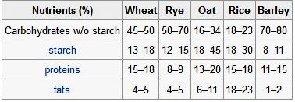
10
Priyanka Goswami, H K College of Pharmacy
Bran is often used to enrich breads and breakfast cereals, especially for the benefit of those wishing to increase their intake of dietary fiber.
Bran may also be used for pickling as in the tsukemono of Japan. In Romania, the fermented wheat bran is usually used when preparing borscht soup.
Rice bran in particular finds many uses in Japan, where it is known as nuka, Besides using it for pickling, Japanese people also add it to the water when boiling bamboo shoots, and use it for dish washing.

Slide 11
11
Priyanka Goswami, H K College of Pharmacy
Use of rice bran as a food item is common among the people of the South Indian state of Kerala. Bran oil may be also extracted for use by itself for industrial purposes (such as in the paint industry), or as a cooking oil, such as rice bran oil.
Animal feed
Bran is widely used as a major component in foods for cattle, American bison, goats, rabbits, guinea pigs, etc.
Rice bran is sometimes fed to horses for its nutritional value, particularly as a plant-based fat supplement. It is considered an excellent way to put weight onto a thin horse, without the problems associated with overfeeding grain. Rice bran is also included in some foods for aging dogs.

Slide 12
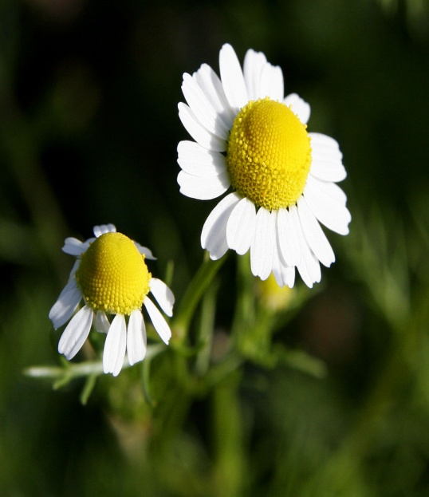
12
Priyanka Goswami, H K College of Pharmacy
6.Chamomile
Syn: Anthemis
Source: dried flowers of entire herb of Matricaria recutita
Family: Compositae
GS: Himalaya, Europe, Egypt
Constituents: Volatile oil: bisabolol, farnesine, pinene, anthelmine, angelic acid
Sesquiterpene lactone: nobilin
Flavonoids: apigenin, Cyanogentic glycoside, Coumarin, tannin, Valerianic acid
Bitter glycoside: anthemic acid
Spiroether
Malic acid

Slide 13
13
Priyanka Goswami, H K College of Pharmacy
Indications:
Principal: stomach upset, minor illness, insomnia, anxiety
Major: dyspepsia, travel sickness, teething pain in children, hemorrhoids
Minor: nasal catarrh, restlessness, would, burn, skin
Contraindications:
Hypersensitive to composite family
Dose:
Infusion: 3 g
Liquid extract: 1-4 ml
1 cup of freshly made tea
TAKEN 20-30 MINUTES BEFORE MEALS & SIPPED SLOWLY

Slide 14
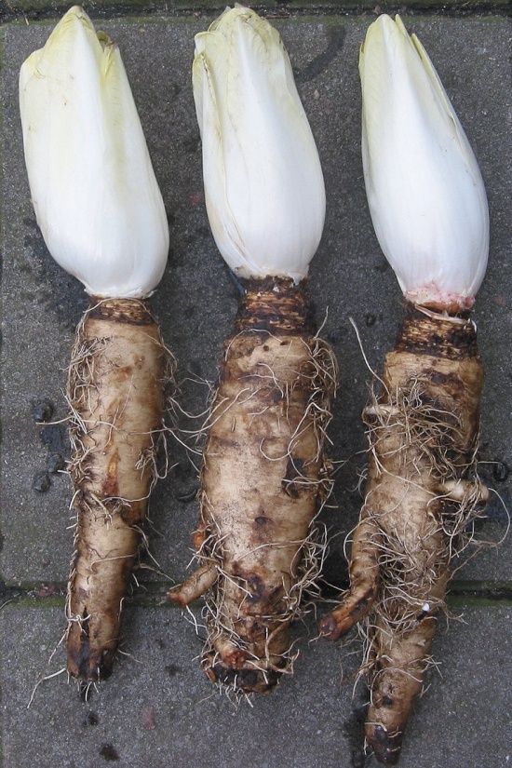
14
Priyanka Goswami, H K College of Pharmacy
7.Chicory
Syn: Kaasani
Source: dried leaves & roots of Cichorium intybus
Family: Compositae
GS: Europe, US, Canda
Constituents: escutetin glycoside: flavonoids, tannin, triterpenoids, unsaturated sterols, umbeliferon, scopoletin
Indications:
Principal: loss of appetite & dyspepsia
Other: Jaundice, gall bladder, liver problem, intestinal worms & diabetes
Dose:
Infusion: 2-4 g single
Powder: 3 g daily

Slide 15
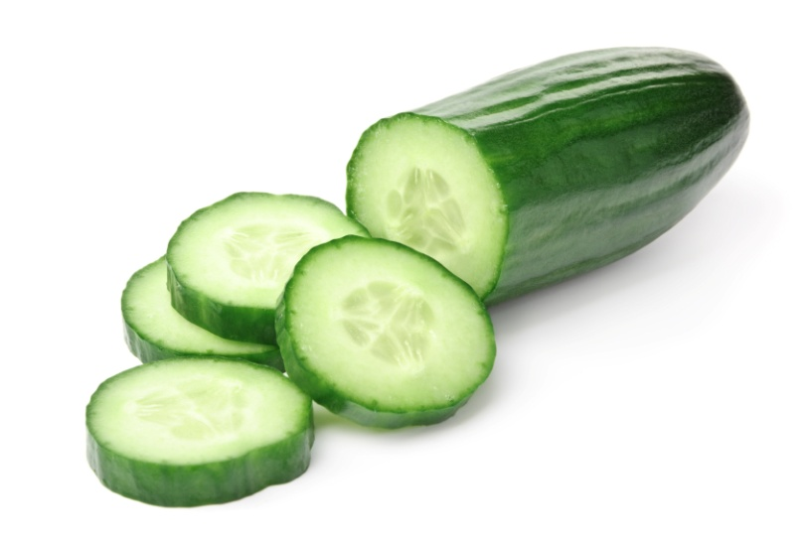
15
Priyanka Goswami, H K College of Pharmacy
8. Cucumber
Syn: Kakadi, Trapusha
Source: dried fruits of Cucumis sativus
Family: Cucurbitaceae
GS: South Asia, now a day everywhere
Constituents: 96% water, oil in the cucumber contains linoleic acid, oleic acid, palmitic acid and stearic acid, Vitamin: C, K, A, B6, B1 folate, pantothenic acid, Mn, P, K, Cu, Mg.
Indication: As a natural diuretic, it promotes the secretion of urine.
A herbal concoction of cucumber and carrot juices is known to lower uric acid content.
The fruit also lowers blood pressure levels.
Cucumber contains an enzyme that helps keep facial skin soft, has a healing and soothing effect on damaged skin, and is a natural sunscreen. It acts as a toner and lightens facial skin.

Slide 16
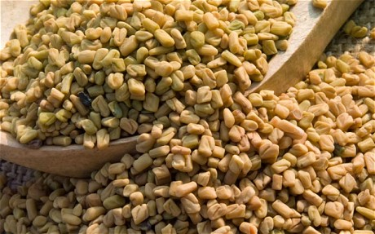
16
Priyanka Goswami, H K College of Pharmacy
9. Fenugreek
Syn: Medhika, Methi
Source: dried ripe seeds of Trigonella foenum-graecum
Family: Leguminosae
GS: tropical-subtropical region
Constituents: Steroidal saponin, fenugreekine, trigonellin, diosgenin
Indication:
Principal: diabetes, hyperlipidemia, hypercholesterolemia,
Major: Digestive aid, increase milk production, ulcer,
Minor: upper respiratory tract infection, menopausal symptoms, arthritis

Slide 17
17
Priyanka Goswami, H K College of Pharmacy
External:
Local inflammation, wound, burn, eczema and boils
Dose:
Internal: 6 g of drug
External: 50 g of drug in 250 ml water

Slide 18
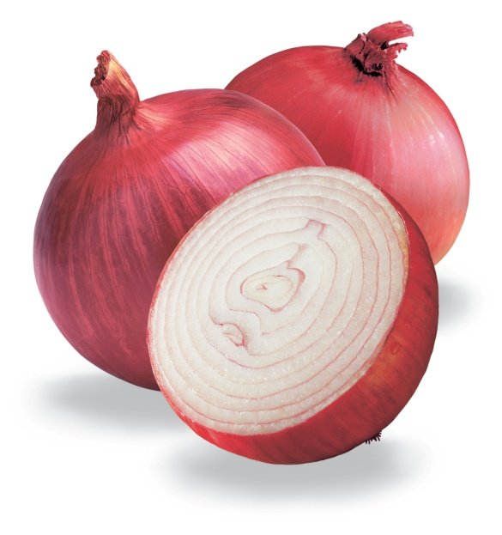
18
Priyanka Goswami, H K College of Pharmacy
10. Onion
Syn: Piyaj, Palandu
Source: dried bulbs of Allium cepa
Family: Liliaceae
GS: Eastern countries
Constituents: sulphur containing compounds disulphides: allicin, allyl propyl disulphide, diallyldisulphide oxide, inorganic materials, alliin, phenolic acids, sterols
Indications: cholesterol lowering, diabetes, anti-bacterial, aphrodiasic, asthama, allergy, convulsions
Dose: juice: 10-20 ml, seeds: 1-3 g

Slide 19
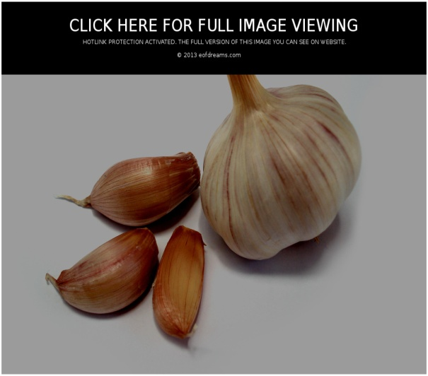
19
Priyanka Goswami, H K College of Pharmacy
11. Garlic
Syn: Lasun
Source: dried bulbs of Allium sativum
Family: Liliaceae
GS: Central asia, India
Constituents: sulphur containing compounds disulphides: allicin, allyl propyl disulphide, diallyldisulphide oxide, inorganic materials, methyl allyl trisulphide, scordinins, selenium

Slide 20
20
Priyanka Goswami, H K College of Pharmacy
Indication:
Principal: hypertension, diabetes, hypercholesterolemia, hyperlipidaemia,
Major: ear infection, helicobacter pylori infection, cold
Minor: GI aid, spasm, digestive aid, flatulence
Contraindication:
10 days before elective surgery
Dose:
One fresh garlic clove 1 to 2 times daily
4 g of garlic
8 ml of essential oil

Slide 21
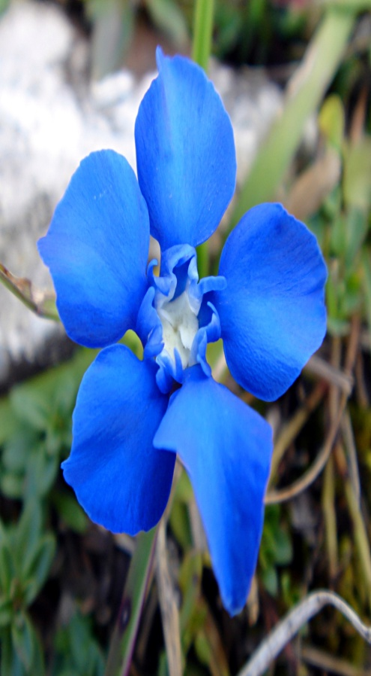
21
Priyanka Goswami, H K College of Pharmacy
12. Gentian
Syn: Girijaa
Source: dried roots & rhizoms of Gentiana lutea (Europe) & Gentiana kurroo (Himalayan)
Family: Gentianaceae
Constituents:
Bitter glycoside: Gentiopicrin, gentiopicroside, amaropanin, amarogentin, amaroswerin, gentiin, gentiamarin
Alkaloid: gentianine
Flavonoid: gentisin

Slide 22
22
Priyanka Goswami, H K College of Pharmacy
Indication:
Principal: dyspepsia, flatulence
Major: loss of appetite
Minor: anorexia, GI atony
Contraindication:
Stomach or duodenal ulcer
Dose:
2-4 g daily
Tincture: 1-4 ml three times daily
Liquid extract: 2-4 g

Slide 23
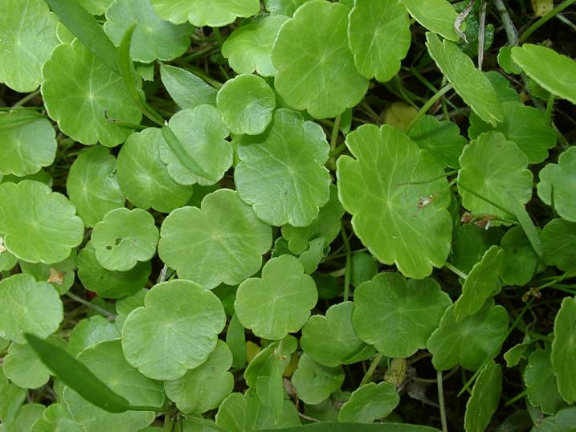
23
Priyanka Goswami, H K College of Pharmacy
13. Hydrocotyle
Syn: Mandukparni, Gotu kola, Indian penny wort
Source: dried leaves & stem of Hydrocotyle asiatica OR Centella asiatica
Family: Hydrocotylaceae
GS: India
Constituents: Triterpenoid saponin: madecassoside, asiaticoside, asiatic acid, madecassic acid, brahminoside, brahmoside, brahmic acid, centelloside
Alkaloid: hydrocotyline
Flavonoid: 3-glucosylquercetin

Slide 24
24
Priyanka Goswami, H K College of Pharmacy
Indication:
Principle: neurodegenerative disorder, memory enhancer, ulcer, burn, skin scar, wound
Major: anxiety, epilepsy, circulatory disorder, rheumatism
Minor: edema, venous hypertension, leprosy, eczema
Contraindication:
pregnancy
Dose:
0.6 g dried leaves or infusion three times daily

Slide 25
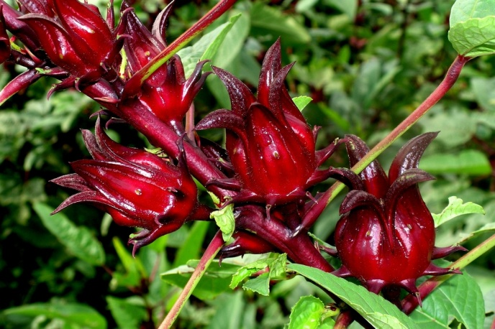
25
Priyanka Goswami, H K College of Pharmacy
14. Hibiscus
Syn: Roselle, Lal-ambari
Source: dried flower heads of Hibiscus sabdariffa
Family: Malvaceae
Constituents: anthocyanins, as well as protocatechuic acid.
flavonoids gossypetin, hibiscetine and sabdaretine.
Pigment: daphniphylline
Small amounts of myrtillin (delphinidin 3-monoglucoside), Chrysanthenin (cyanidin 3-monoglucoside), and delphinidin are also present.
lipid-soluble antioxidants, particularly gamma-tocopherol.

Slide 26
26
Priyanka Goswami, H K College of Pharmacy
Indication:
Principle: loss of appetite, cold that affects respiratory tract, hypertension
Minor: inflammation, conjunctivitis, herpes zoster
Dose:
Tea: boil 1.5 g of powdered in water & strain after 10 minutes

Slide 27
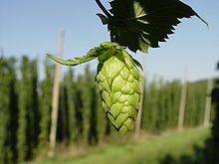
27
Priyanka Goswami, H K College of Pharmacy
15. Hops
Source: dried strobiles of Humulus lupulus
Family: Cannabaceae
GS: England, Germany, Belgium, France, Russia, California
Constituents: Terpene: Humulene, 3-methyl butanoic acid
Phloroglucinol derivative: Humulone, lupulone, resin
2,3,4-trithiapentane, S-methyl-thio-2-methylbutanoate

Slide 28
28
Priyanka Goswami, H K College of Pharmacy
Indication:
Principle: restlessness, nervousness, anxiety disorder, sleep disturbances
Major: Menopause, headache, indigestion
Minor: leg ulcer, edema, neuralgia
Contraindication:
Pregnancy & depression
Dose:
Up to 3 times daily and before going to bed
Infusion: 0.5-1g
Liquid extract: 1:1 in 45% ethanol
Tincture: 0.5-1 ml in 1:5 60% ethanol

Slide 29
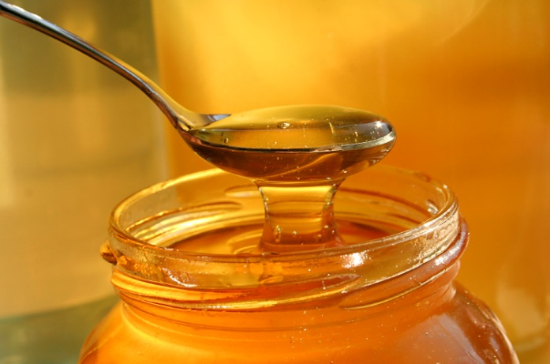
29
Priyanka Goswami, H K College of Pharmacy
16.Honey
Syn: Madhu
Source: sugar secretion deposited in honey comb by bees Apis mellifera, Apis dorsata
Family: Apidae Order: Hymenoptera
GS: Africa, Australia, New Zealand, India, California
Constituents: glucose, fructose, sucrose, maltose, gum, traces of succinic acid, acetic acid, dextrin, formic acid, coloring mattervitamin traces,
pollen grain
Enzyme: Invertase, diastase, inulase
Proteins
Indication: nutritive, in cough

Slide 30
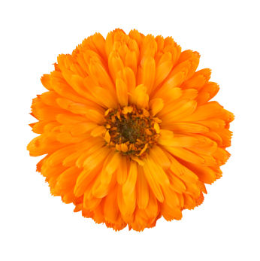
30
Priyanka Goswami, H K College of Pharmacy
17. Marigold
Source: dried flower of Calendula officinalis
Family: Compositae
GS: Europe, US, Canada
Constituents:
Flavonoids: quercetin, isorhamnetin dvt
Triterpenoids: calendulosides
essential oil: amyrin
Carotenoids
Polysaccharides: rhamnose, arabinose, galactose

Slide 31
31
Priyanka Goswami, H K College of Pharmacy
Indication:
Principal: wound healing, mosquito bites, bee stings, cuts, sprains, inflammation, conjunctivitis [external]
Internal:
Major: varicose veins n prophylaxis
Minor: amenorrhea, dysmenorrhea
Dose:
Infusion: 1-2 g in divided doses
Liquid extract: 1.5-4.5 ml per day in divided doses
Tincture: 0.3-1.2 ml 3 times a day
External: 1:3 dilute

Slide 32
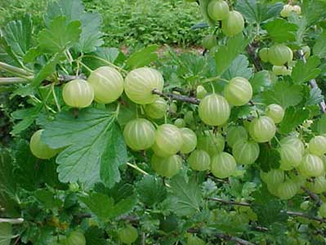
32
Priyanka Goswami, H K College of Pharmacy
18. Amla
Syn: Amalaki, Indian gooseberry
Source: dried ripe fruits of Phyllanthus emblica
Family: Euphorbiaceae
GS: India, Srilanka, Myanmar
Constituents: Hydrolysable tannins: Gallic acid, Ellagic acid, vitamin C, amino acids, phyllemblin
Indication: As a rejuvenative herb, it nourishes body tissues and accelerates the cell regeneration process.
As a powerful antioxidant, Emblic Myrobalan helps scavenge free radicals linked to premature aging.
It helps in building the body’s immune system and provides resistance against many diseases, especially those of the respiratory tract.

Slide 33
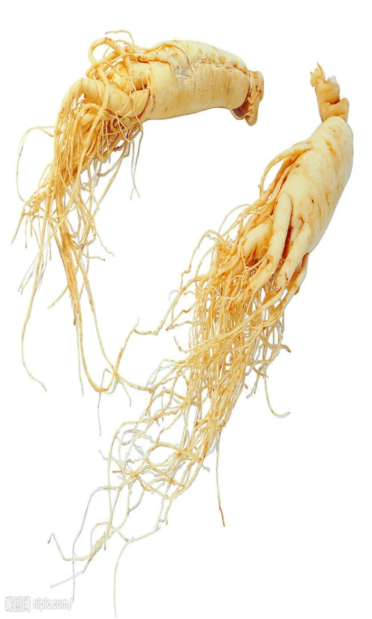
33
Priyanka Goswami, H K College of Pharmacy
19.Ginseng
Syn: Ninjin
History: human body root
Source: dried roots of Panax ginseng (Korea), Panax quinquefolium (US)
Family: Araliaceae
Constituents:
Ginsenosides: dammarol
Panaxosides: oleanic acid, panaxodiol, panaxotriol
chikusetsusaponin

Slide 34
34
Priyanka Goswami, H K College of Pharmacy
Indication:
Principal: physical-mental exhaustion, stress, fatigue
Major: hyperglycemia, erectile dysfunction, menopausal symptoms, aging, CVS
Contraindication:
Coronary thrombosis, acute illness, pregnancy
Dose:
Decoction: 0.6-2 g daily in the morning

Slide 35

35
Priyanka Goswami, H K College of Pharmacy
20.Ashwagandha
Syn: Withania
History: smells like horse foot
Source: dried roots of Withania somnifera
Family: Solanaceae
GS: India
Constituents: triacontane, dihydroxystigmasterol, amino acid
Alkaloid: withanine, somnine
Steroid lactone: Withanolides, withaferine A, withanone
Indication: sedative, alterative, diuretic, emetic, dyspepsia, flatulence, liver complains, asthma, nervic tonic
Dose: 3-6 g

Slide 36
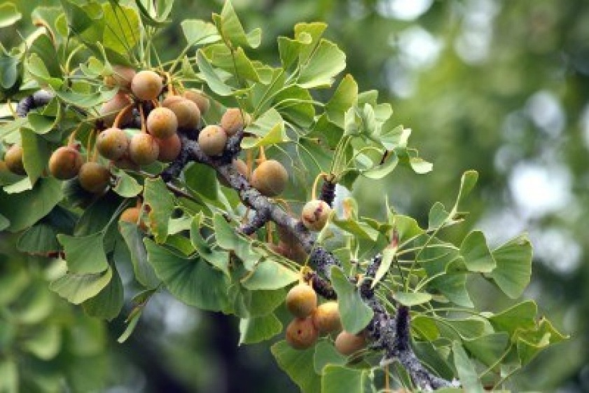
36
Priyanka Goswami, H K College of Pharmacy
21. Ginkgo
Source: dried leaves and seeds of Ginkgo biloba
Family: Ginkgoaceae
GS: China, Japan
Constituents: flavonoids: mono, di, tri glycosides of kaempferol, quercetin, myrecetin, iso-rhamnetin dvt.
Alkyl phenol: urushiol: ginkgolic acid
Ginkgolides
Indication: memory loss, dementia, alzheimer, vertigo, sudden deafness, motion sickness, asthma, glaucoma, retinopathy
Dose: Asthma: 40 mg 3 times daily, dementia: 120-240 mg extract in divided doses, vertigo: 120-320 mg extract in divided doses, Glaucoma: 120 mg

Slide 37
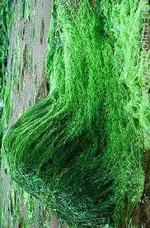
37
Priyanka Goswami, H K College of Pharmacy
22. Spirulina
Source: blue-green algae, Spirulina platensis & Spirulina maxima
Family: Oscillatoriaceae
GS: US, Thailand, Mexico, India, China
Constituents: proteins, protenous nitrogen, total organic nitrogen, lipid, fatty acid, Vitamin F
Carbohydrate: glycogen, rhamnose
Vitamin: B complex, beta carotene
Algal protein: phycobiliprotein
Indication: immunostimulatory, hypolipidemic, antiviral, anti-inflammatory and anticancer effects

Slide 38
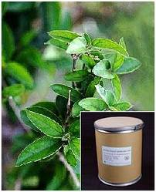
38
Priyanka Goswami, H K College of Pharmacy
23. Gymnema
Syn: Gurmar, Madhunashini
Source: dried leaves of Gymnema sylvestre
Family: Asclepiadaceae
GS: India
Constituents:
Triterpenoid saponin & anthraquinone dvt
pentriacontane, hentriacontane, phytin, tartaric acid, formic acid, mucilage, butyric acid, inositol, quercitol, gymnemic acid
Alkaloid, betain, choline, triethylamine
Indication: Diabetes, cholesterolemia, triglyceridemia, sweet taste suppression, weight loss
Dose: 400-600 mg/day in divided dose with meal.

Slide 39
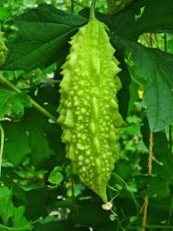
39
Priyanka Goswami, H K College of Pharmacy
24. Momordica
Syn: Karela, bitter melon
Source: dried ripe fruits and leaves of Momordica chirantia
Family: Cucurbitaceae
GS: India
Constituents: momordicin I and momordicin II, and cucurbitacin B.
Glycosides: momordin, charantin, charantosides, goyaglycosides, momordicosides
Terpenoids: momordicin-28, momordicinin, momordicilin, momordenol, and momordol
cytotoxic (ribosome-inactivating) proteins such as momorcharin and momordin
Steroidal saponin: charantin
Carbohydrate, mineral, ascorbic acid

Slide 40
40
Priyanka Goswami, H K College of Pharmacy
Indication:
Principal: diabetes, Cancer (breast, lung, colon, gall bladder), HIV
Major: cholesterol, worms, viral, headache
Minor: emmenagogue, which stimulate blood flow in the pelvic area and uterus; some stimulate menstruation
Contraindication:
Hypoglycemia
Dose:
100 g of aqueous extract in 100 ml juice daily

Slide 41
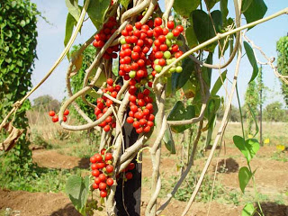
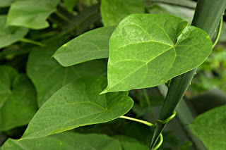
41
Priyanka Goswami, H K College of Pharmacy
25. Tinospora
Syn: Guduchi, Gulvel
Source: dried stem, root & flower of Tinospora cordifolia
Family: Menispermaceae
GS: India, Myanmar, Srilanka
Constituents:
Diterpene: tinosporidine, Polyphenols
Tinosporone, tinosporic acid, cordifolide
Polysaccharide: arabinogalactan
Glucoside: tinocrisposid
Indication: antipyretic, anti-inflammatory, anti-arthritic, anti-allergic, hepatoprotective, hypoglycemic, CNS depressant, Immunomodulatory
Dose: 5-10 ml as juice or decoction

